Slide 1
Title : Next Word Predictor
UE20CS302 – Machine Intelligence
Mini Project
Project Team with SRNs :
Student name 1: Venkata Sathvik Addepalli SRN:PES1UG20CS493
Student name 2: Y Srinivas SRN:PES1UG20CS517
Student name 3: Vrushank G SRN: PES1UG20CS516

Slide 2
Problem Statement
Next Word Prediction is the task of predicting what word comes next. It is one of the fundamental tasks of NLP(Natural Language Processing) and has many applications. We might use it daily when we write texts or emails.
Deep learning is a subclass of machine learning. The succeeding word forecast is performed on dataset consisting of texts. Next Word Prediction is an application of NLP. It is also known as Language Modelling.
Several models are used for predicting with different performances. The best computed accuracy model is considered.
Notes:
Provide a basic introduction of the project and also an overview of scope it entails.
Set the context.

Slide 3
Application and Uses
1 . The next word prediction for a particular user’s texting or typing can be really time saving. It would save a lot of time by understanding the user’s patterns of texting. This could be also used by our virtual assistant to complete certain sentences.
2 . Word prediction programs prompt the user with a list of likely word choices based on words previously typed. Some word prediction software automatically collects new words as they are used and considers a person's common vocabulary when predicting words in the future.
3 . It has become popular in on-screen keyboards on mobile devices and tablets. Word prediction software assists with reducing the number of required keystrokes, by predicting the word you are typing and the next word based on word frequency and context.
4 . There are also advanced word prediction tools available. They include:
i. Tools that read word choices aloud with text-to-speech. This is important for those with reading issues who can’t read what the suggestions are.
ii. Word prediction tools that make suggestions tailored to specific topics. For instance, the words used in a history paper will differ a lot from those in a science report.
iii. Tools that display word suggestions in example sentences. This can help kids decide between words that are confusing, like to, too and two.
Notes:
Provide a basic introduction of the project and also an overview of scope it entails.
Set the context.

Slide 4
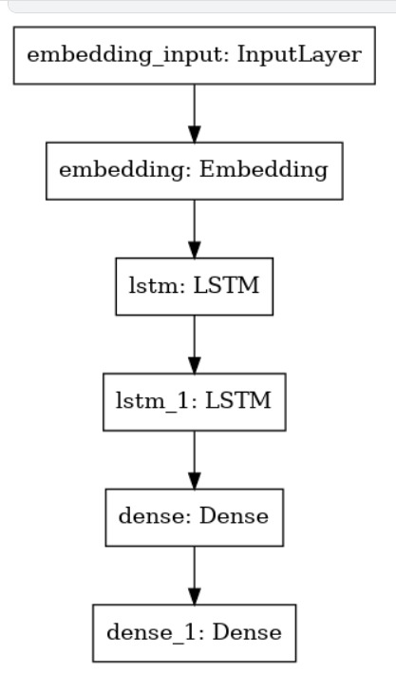
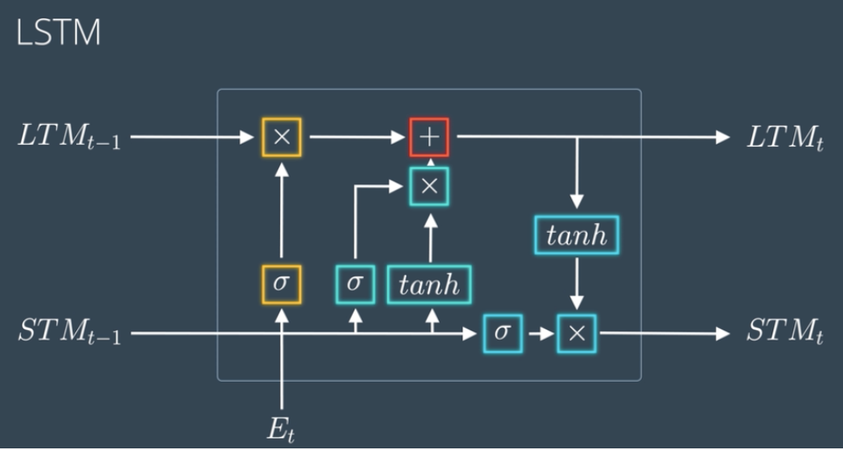
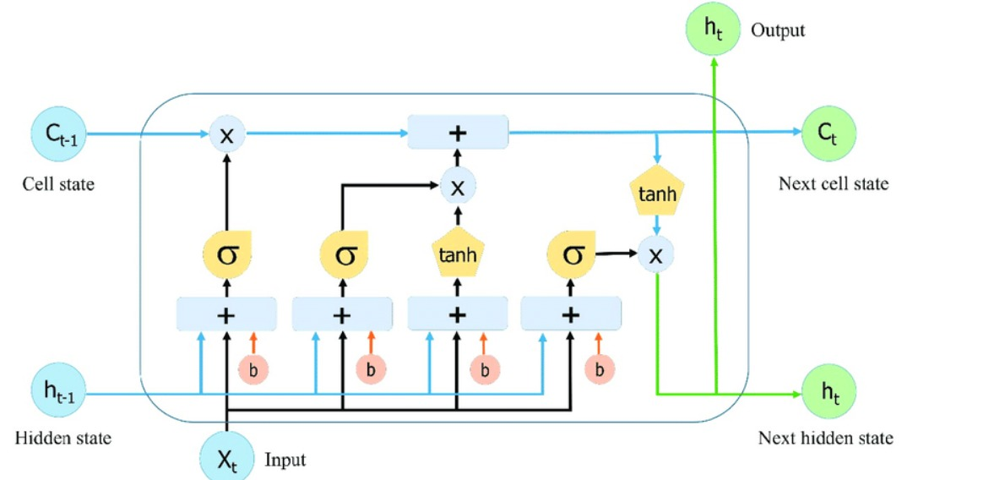
High level Architecture
LSTMs deal with both Long Term Memory (LTM) and Short Term Memory (STM) and for making the calculations simple and effective it uses the concept of gates
Markov Chain is a mathematical model of stochastic process that predicts the condition of the next state based on the condition of the previous one. Using this principle, the Markov Chain can predict the next word based on the last word typed.
Notes:
Provide a basic introduction of the project and also an overview of scope it entails.
Set the context.

Slide 5
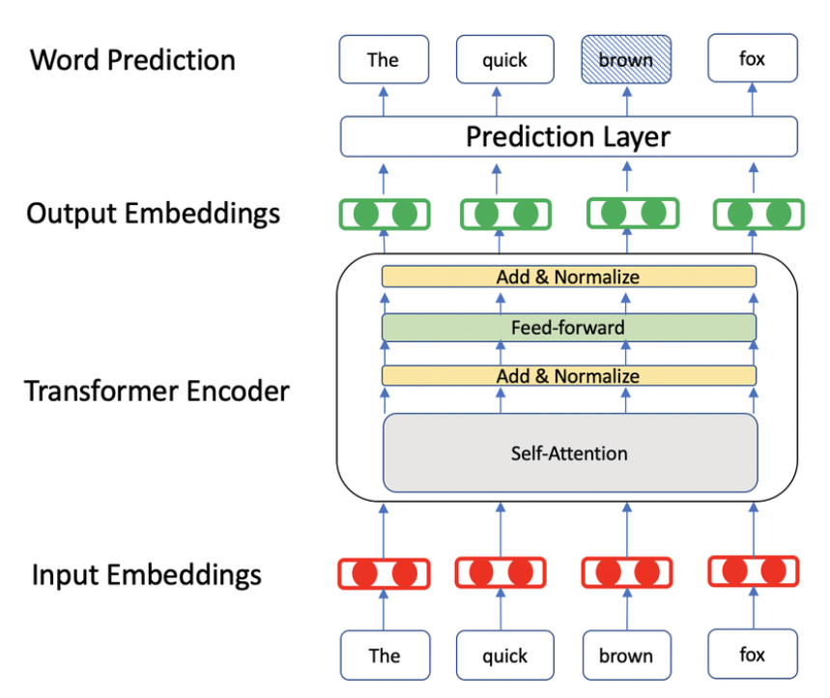
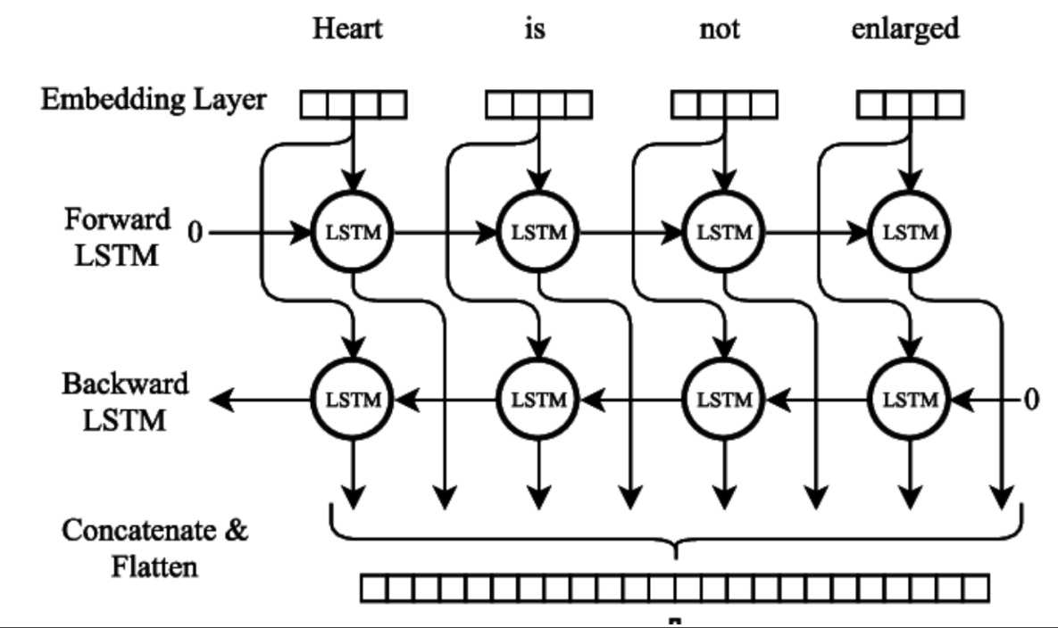
High level Architecture
Illustration of BERT model for predicting the masked word ‘BROWN’
Modelling Radiological Language with Bidirectional Long Short-Term Memory Networks(Bi-LSTM), Cornegruta et al
Notes:
Provide a basic introduction of the project and also an overview of scope it entails.
Set the context.

Slide 6
Literature Survey
Title of the paper | Year of Publication | Journal/Conference Name | Advantages | Limitations
Next Word Prediction Using Deep Learning: A Comparative Study | 2022 | 12th International Conference on Confluence The Next Generation Information Technology Summit (Confluence) | The models on which this experimentation is performed achieved higher accuracies for both LSTM and BiLSTM models than the same models used for English Language. | The accuracy received using BiLSTM and LSTM are: 66.1% and 58.27% respectively.
Next Word Prediction in Hindi Using Deep Learning Techniques | 2019 | International Conference on Data Science and Engineering | Aids the non-native users in learning the language by suggesting new and correct words to them, thus expanding their vocabulary | The processing of the Hindi language is very difficult as it contains a lot of mantras and symbols. This can result in irrelevant results due to the confusion of spellings. Hence, processing the language at the word level gives better results and is less complex.
Advances in NLP applied to Word Prediction | 2008 | University of Pisa | Use of POS tags for refining the prediction algorithms | Have not reached to a stage of usage and implementation
Notes:
Provide summary of Phase – 1.
Include the suggestions and improvements made.

Slide 7
Literature Survey
Title of the paper | Year of Publication | Journal/Conference Name | Advantages | Limitations
Predicting the next word using the Markov Chain Model according to profiling personality | 2021 | Springer Nature 2021 | Successful in identifying and detecting the accuracy of the personality prediction and suggesting the target words for each user | Development of real model to precisely profile the user’s personality
Natural Language Generation in the form of next word prediction using Markov chains | 2017 | TECHNICAL UNIVERSITY OF CRETE School of ENGINEERING COMPUTERS | a model of higher complexity needs more data for training
Next Words Prediction Using Recurrent NeuralNetworks | 2021 | ITM Web of Conferences 40 | current pre-arranged designs for corpus are used by looking on the web for open-source executions | Lower accuracies even after tuning the hyperparameters
Notes:
Provide summary of Phase – 1.
Include the suggestions and improvements made.

Slide 8
Literature Survey
Title of the paper | Year of Publication | Journal/Conference Name | Advantages | Limitations
NEXT WORD PREDICTION AND CORRECTION SYSTEMUSING TENSORFLOW | 2017 | BMSCE | predicting and correcting the next/target words using some mechanisms and using TensorFlow closed loop system, the scalability of trained system can be increased | The scalability of trained system can be increased and using perplexity concept the system will decide that the sentence is having more misspelt and the performance of the system can be increased.
Notes:
Provide summary of Phase – 1.
Include the suggestions and improvements made.

Slide 9
Proposed Approach
Our Dataset
Our dataset is a text file called “Pride And Prejudice.txt” which has been loaded onto Google Collab for applying the further mentioned models on it (LSTM and BERT respectively) such that the models can predict the next word based on the learning it has received after being trained on the dataset we have used.
Notes:
Provide summary of Phase – 1.
Include the suggestions and improvements made.

Slide 10
Proposed Approach
Using LSTM
Steps:
1. Preprocessing the dataset using tokenizers. Tokenizers are required so that we can split into each word and store them.
2. Feature Engineering is done by converting the words into numerical form so that it is easy to process them
3. Storing features and labels:
X will be used to get the features and Y to get the labels associated with them.
4. LSTM model is built using softmax activation at the end to get few specific words predicted by the model.
5. The model training uses Adam as the optimizer with a learning rate of 0.01 and uses categorical cross-entropy for loss function with a batch size of 64.
6. Evaluating the model.
7. Predicting the next words.
Notes:
Provide summary of Phase – 1.
Include the suggestions and improvements made.

Slide 11
Proposed Approach
Using BERT
Steps:
Loading Uncased-Bert Model and Tokenizers
Add mask to the text because BERT uses MLM(masked language model) for pretraining
Encoding and Decoding : These are the steps which are followed for using Transformer Neural Networks
Implementing wrapper function for encoding and decoding functions
Preparing a user interface for computing and displaying the results
Notes:
Provide summary of Phase – 1.
Include the suggestions and improvements made.

Slide 12
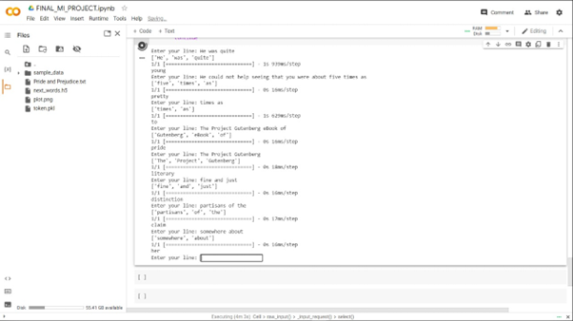
Results and Discussion
Next word prediction is one of NLP’s major fields because it’s about mining the text. Our Project here used the LSTM model to make the prediction with 70 epochs. The result showed that it maintained to get accuracy 75% while the loss was 55%. Based on that result, it could be said the accuracy is good enough. As it also showed that it’s better than two of the two other researches which used different models. The model could be used to predict the next word by giving the input of the destination.
Notes:
Provide summary of Phase – 1.
Include the suggestions and improvements made.

Slide 13
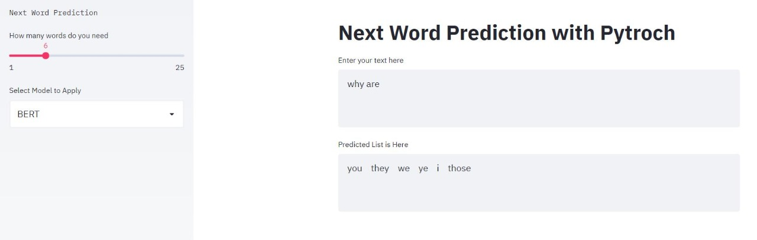
Results and Discussion
Using the BERT model the accuracy boosts to a better level as it is developed by Google in the recent years(2018) and tends to be a game changer in the NLP field. It’s bidirectional
It combines Mask Language Model (MLM) and Next Sentence Prediction (NSP).
So far, it’s the best method in NLP to understand context-heavy texts
Notes:
Provide summary of Phase – 1.
Include the suggestions and improvements made.

Slide 14
Conclusion
BERT is an open source machine learning framework for natural language processing (NLP) which is designed to help computers understand the meaning of ambiguous language in text by using surrounding text to establish context.
The name of LSTM refers to the analogy that a standard RNN has both "long-term memory" and "short-term memory". It consists of an input gate, output gate and forever gate. LSTM networks are well-suited to classifying, processing and making predictions based on time series data. They are developed to deal with the vanishing gradient problem.
We compared both BERT and LSTM model and concluded that Using LSTM, our models can predict next word based on previous, sequential data.
Notes:
Provide summary of Phase – 1.
Include the suggestions and improvements made.

Slide 15
References
A Gentle Introduction to Long Short-Term Memory Networks by the Experts - MachineLearningMastery.com
https://www.ibm.com/cloud/learn/recurrent-neural-networks
https://huggingface.co/blog/bert-101
Notes:
Provide summary of Phase – 1.
Include the suggestions and improvements made.

Slide 16
Thank You

